Slide 1
Applying epidemiological estimates
Anoop Shah
Clinical lecturer in Cardiology
Royal Infirmary of Edinburgh

Slide 2
Objectives
Definitions
Type of epidemiological estimates
Measures of public health impact
PAF
Burden of disease
Exercise
Causal inference
Real world example of use of PAF to estimate burden of disease

Slide 3
Definitions
Disease
A disease is a particular abnormal condition that negatively affects the structure or function of part or all of an organism, and that is not due to any external injury
Risk factor
A risk factor is any attribute, characteristic or exposure of an individual that increases the likelihood of developing a disease or injury.
Causal inference
Inferring the cause of something has been described as:
- "...reason[ing] to the conclusion that something is, or is likely to be, the cause of something else".
- "Identification of the cause or causes of a phenomenon, by establishing covariation of cause and effect, a time-order relationship with the cause preceding the effect, and the elimination of plausible alternative causes."

Slide 4
Types of epidemiological estimates / measures of risk
Descriptive /
Frequency/
Count
Measures of association
Measures of public health impact
Notes:
Ratio = 3,151 ⁄ 189 × 1 = 16.7:1. This is a ratio

Slide 5
Types of epidemiological estimates / measures of risk
Proportionate mortality
Incident rate ratios
Proportions
Descriptive /
Frequency/
Count
Measures of association
Odds ratio
Rate
Risk ratio
Measures of public health impact
Notes:
Ratio = 3,151 ⁄ 189 × 1 = 16.7:1. This is a ratio

Slide 6
Types of epidemiological estimates
Proportionate mortality
Incident rate ratios
Proportions
Descriptive /
Frequency/
Count
Measures of association
Odds ratio
Rate
Risk ratio
Incidence
Measures of public health impact
Prevalence
Notes:
Ratio = 3,151 ⁄ 189 × 1 = 16.7:1. This is a ratio

Slide 7
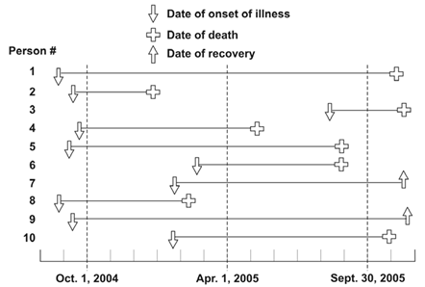
Incidence and prevalence
Figure 3.1 represents 10 new cases of illness over about 15 months in a population of 20 persons. Each horizontal line represents one person. The down arrow indicates the date of onset of illness. The solid line represents the duration of illness. The up arrow and the cross represent the date of recovery and date of death, respectively.
Examples from https://www.cdc.gov/ophss/csels/dsepd/ss1978/lesson3/section1.html
Notes:
Incidence refers to the occurrence of new cases of disease or injury in a population over a specified period of time. Although some epidemiologists use incidence to mean the number of new cases in a community, others use incidence to mean the number of new cases per unit of population.
Incidence rate or person-time rate is a measure of incidence that incorporates time directly into the denominator. A person-time rate is generally calculated from a long-term cohort follow-up study, wherein enrollees are followed over time and the occurrence of new cases of disease is documented.

Slide 8
Calculate the incidence rate from October 1, 2004, to September 30, 2005, using the midpoint population (population alive on April 1, 2005) as the denominator. Express the rate per 100 population.
Examples from https://www.cdc.gov/ophss/csels/dsepd/ss1978/lesson3/section1.html
Notes:
Incidence rate numerator = number of new cases between October 1 and September 30 = 4 (the other 6 all had onsets before October 1, and are not included)
Incidence rate denominator = April 1 population = 18 (persons 2 and 8 died before April 1)
Incidence rate = (4 ⁄ 18) × 100 = 22 new cases per 100 population

Slide 9
Calculate the point prevalence on April 1, 2005. Point prevalence is the number of persons ill on the date divided by the population on that date.
Examples from https://www.cdc.gov/ophss/csels/dsepd/ss1978/lesson3/section1.html
Notes:
Definition of prevalence
Prevalence, sometimes referred to as prevalence rate, is the proportion of persons in a population who have a particular disease or attribute at a specified point in time or over a specified period of time. Prevalence differs from incidence in that prevalence includes all cases, both new and preexisting, in the population at the specified time, whereas incidence is limited to new cases only.
Point prevalence refers to the prevalence measured at a particular point in time. It is the proportion of persons with a particular disease or attribute on a particular date.
Period prevalence refers to prevalence measured over an interval of time. It is the proportion of persons with a particular disease or attribute at any time during the interval.
Point prevalence = (7 ⁄ 18) × 100 = 38.89%

Slide 10
Calculate the period prevalence from October 1, 2004, to September 30, 2005. The numerator of period prevalence includes anyone who was ill any time during the period.
Examples from https://www.cdc.gov/ophss/csels/dsepd/ss1978/lesson3/section1.html
Notes:
Period prevalence = (10 ⁄ 20) × 100 = 50.0%

Slide 11
Types of epidemiological estimates
Proportionate mortality
Incident rate ratios
Proportions
Descriptive /
Frequency/
Count
Measures of association
Rate
Odds ratio
Measures of public health impact
Notes:
Ratio = 3,151 ⁄ 189 × 1 = 16.7:1. This is a ratio

Slide 12
Incidence risk ratios
In an outbreak of tuberculosis among prison inmates in South Carolina in 1999, 28 of 157 inmates residing on the East wing of the dormitory developed tuberculosis, compared with 4 of 137 inmates residing on the West wing. These data are summarized in the two-by-two table so called because it has two rows for the exposure and two columns for the outcome. Here is the general format and notation.
 |  | Disease
 | Yes | No | Total
East Wing | 28 | 129 | 157
West Wing | 4 | 133 | 137
Total | 32 | 262 | 294

Slide 13
Incidence risk ratios
Are inmates in the east wing more likely to get TB and if so by how much
 |  | Disease
 | Yes | No | Total
East Wing | 28 | 129 | 157
West Wing | 4 | 133 | 137
Total | 32 | 262 | 294
Notes:
Risk of tuberculosis among East wing residents = 28 ⁄ 157 = 0.178 = 17.8%
Risk of tuberculosis among West wing residents = 4 ⁄ 137 = 0.029 = 2.9%
The risk ratio is simply the ratio of these two risks:
Risk ratio = 17.8 ⁄ 2.9 = 6.1
Thus, inmates who resided in the East wing of the dormitory were 6.1 times as likely to develop tuberculosis as those who resided in the West wing.

Slide 14
Odds ratio
Are inmates in the east wing more likely to get TB and if so by how much – so what is the odds ratio?
 |  | Disease
 | Yes | No | Total
East Wing | 28 | 129 | 157
West Wing | 4 | 133 | 137
Total | 32 | 262 | 294
Notes:
The odds ratio (OR) is a statistic defined as the ratio of the odds of A in the presence of B and the odds of A without the presence of B.
Odds of disease in the East wing = 28/129 = 0.21
Odds of disease in the West wing = 4/133 = 0.03
Odds ratio = 7

Slide 15
Types of epidemiological estimates / measures of risk
Proportionate mortality
Incident rate ratios
Proportions
Descriptive /
Frequency/
Count
Measures of association
Odds ratio
Rate
Risk ratio
Measures of public health impact
Notes:
Ratio = 3,151 ⁄ 189 × 1 = 16.7:1. This is a ratio

Slide 16
Public health impact
Descriptive /
Frequency/
Count
Measures of association
Measures of public health impact
Attributable
risk
Number needed to treat
Population Attributable risk
Notes:
A measure of public health impact is used to place the association between an exposure and an outcome into a meaningful public health context.
Whereas a measure of association quantifies the relationship between exposure and disease, and thus begins to provide insight into causal relationships, measures of public health impact reflect the burden that an exposure contributes to the frequency of disease in the population.
Two measures of public health impact often used are the attributable proportion and efficacy or effectiveness.

Slide 17
Attributable risk
In another study of smoking and lung cancer, the lung cancer mortality rate among nonsmokers was 0.07 per 1,000 persons per year. The lung cancer mortality rate among persons who smoked 1–14 cigarettes per day was 0.57 lung cancer deaths per 1,000 persons per year. Calculate the attributable proportion.
Calculate the risk ratio?
Calculate the attributable proportion?
Remember the attributable proportion is the risk difference / risk in the exposed group x 100
Notes:
Risk ratio = 8.14
AR = 0.57 – 0.07 / 0.57 = 0.87 or 87%

Slide 18
Attributable risk
In another study of smoking and lung cancer, the lung cancer mortality rate among nonsmokers was 0.07 per 1,000 persons per year. The lung cancer mortality rate among persons who smoked 1–14 cigarettes per day was 0.57 lung cancer deaths per 1,000 persons per year. Calculate the attributable proportion.
Calculate the risk ratio?
Calculate the attributable proportion?
Alternative formula
AR = (RR – 1)/ RR
Notes:
Risk ratio = 8.14
AR = 0.57 – 0.07 / 0.57 = 0.87 or 87%

Slide 19
Population Attributable risk
Population Attributable Risk (or Population Attributable Fraction) indicates the number (or proportion) of cases that would not occur in a population if the factor were eliminated
So for this metric we need one additional parameter?
Notes:
Risk ratio = 8.14
AR = 0.57 – 0.07 / 0.57 = 0.87 or 87%

Slide 20
Population Attributable risk
Population Attributable Risk (or Population Attributable Fraction) indicates the number (or proportion) of cases that would not occur in a population if the factor were eliminated
So for this metric we need one additional parameter?
Prevalence
PAR = P_{e} (RR_{e}-1) / [1 + P_{e} (RR_{e}-1)]

Slide 21
Calculate the hypothetical case where
Prevalence is
0% - 0%
10% - 41%
50% - 78%
80% - 85%
100% - 88%
PAR = P_{e} (RR_{e}-1) / [1 + P_{e} (RR_{e}-1)]

Slide 22
Calculate the hypothetical case where
Prevalence is
0% - 0%
10% - 41%
50% - 78%
80% - 85%
100% - 88%
PAR = P_{e} (RR_{e}-1) / [1 + P_{e} (RR_{e}-1)]

Slide 23
Calculate the hypothetical PAF where
Prevalence is
0% -
10% -
50% -
80% -
100% -
PAR = P_{e} (RR_{e}-1) / [1 + P_{e} (RR_{e}-1)]

Slide 24

RRR, ARR and NNT

Slide 25
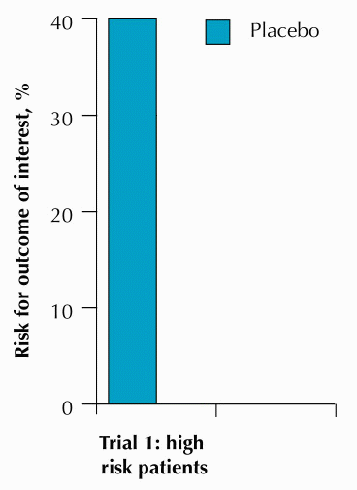
RRR, ARR and NNT
New drug for acute myocardial infarction to reduce mortality
First studied in a high risk population:
40% mortality at 30 days among untreated
e.g., elderly, heart failure, anterior wall infarction
Ref: http://www.cche.net/usersguides/ebm_tips.asp

Slide 26
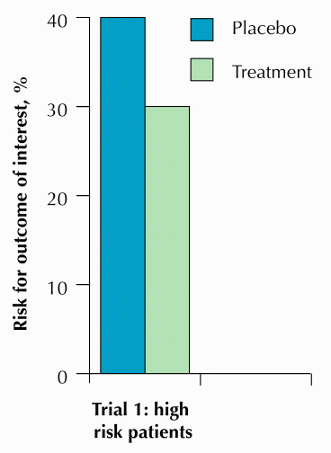
RRR, ARR and NNT
New drug for acute myocardial infarction to reduce mortality
First studied in a high risk population:
40% mortality at 30 days among untreated
e.g., elderly, heart failure, anterior wall infarction
30% mortality among treated
How would you describe the effect of the new drug?
Ref: http://www.cche.net/usersguides/ebm_tips.asp

Slide 27
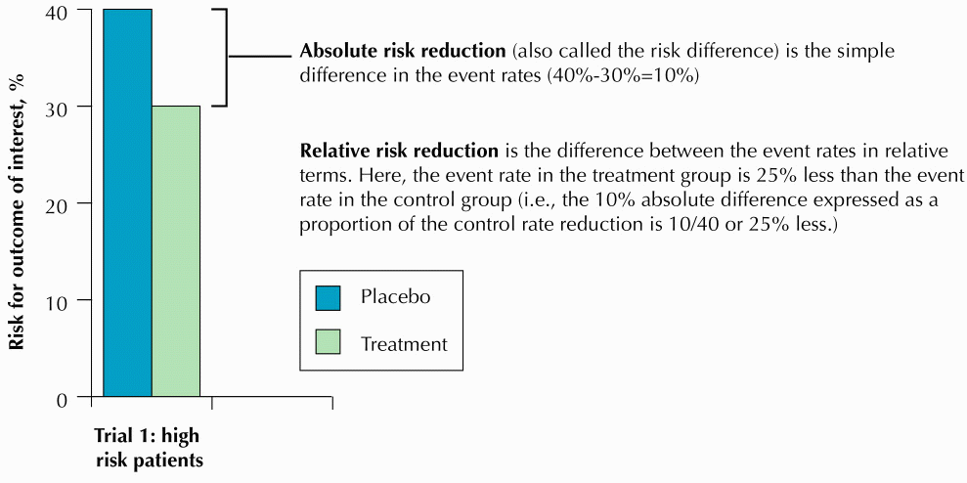
RRR, ARR and NNT
Ref: http://www.cche.net/usersguides/ebm_tips.asp

Slide 28
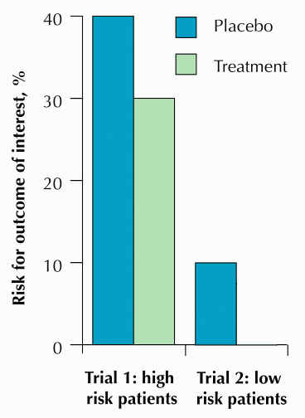
RRR, ARR and NNT
New drug for acute myocardial infarction to reduce mortality
Later studied in a lower risk population:
10% mortality at 30 days among untreated
e.g., younger, uncomplicated inferior wall infarction
Ref: http://www.cche.net/usersguides/ebm_tips.asp

Slide 29
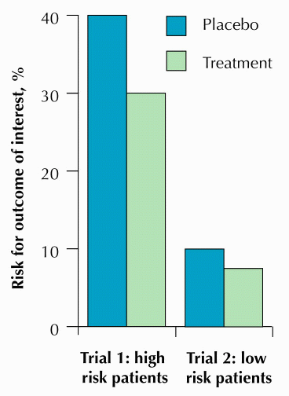
RRR, ARR and NNT
New drug for acute myocardial infarction to reduce mortality
Later studied in a lower risk population:
10% mortality at 30 days among untreated
e.g., younger, uncomplicated inferior wall infarction
7.5% mortality among treated
How would you describe the effect of the new drug?
Ref: http://www.cche.net/usersguides/ebm_tips.asp

Slide 30
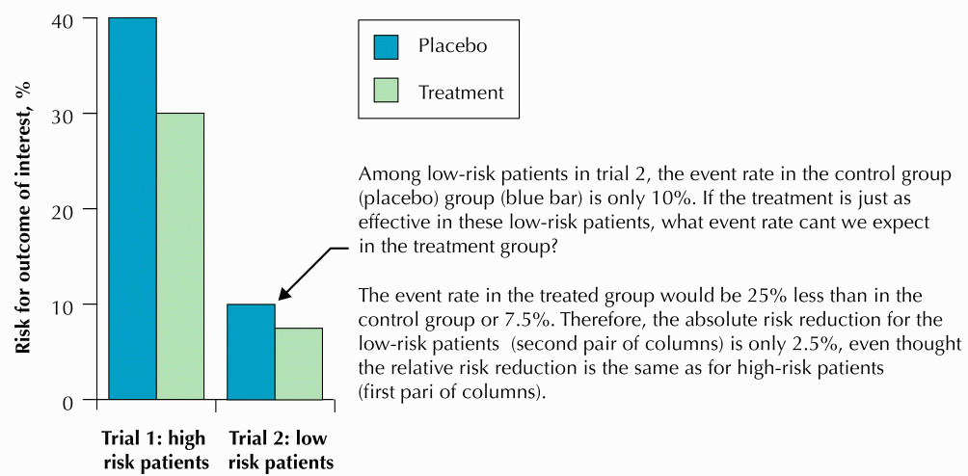
RRR, ARR and NNT
Ref: http://www.cche.net/usersguides/ebm_tips.asp

Slide 32
What is the NNT for trial 1 and trial 2
Ref: http://www.cche.net/usersguides/ebm_tips.asp

Slide 33

Exercise
Global Burden of Atherosclerotic Cardiovascular Disease in People Living With HIV
Circulation. 2018;138:1100–1112

Slide 34
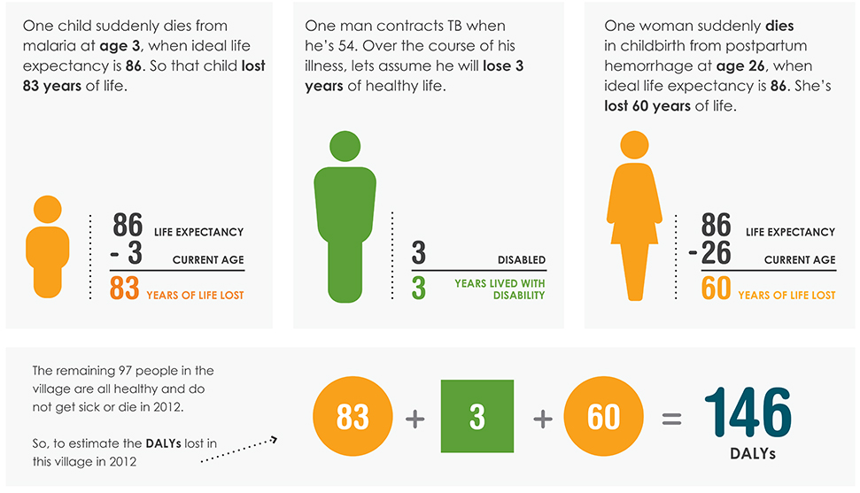
Disability adjusted life years
Let’s Say There is a Village of 100 People in 2012…

Slide 35
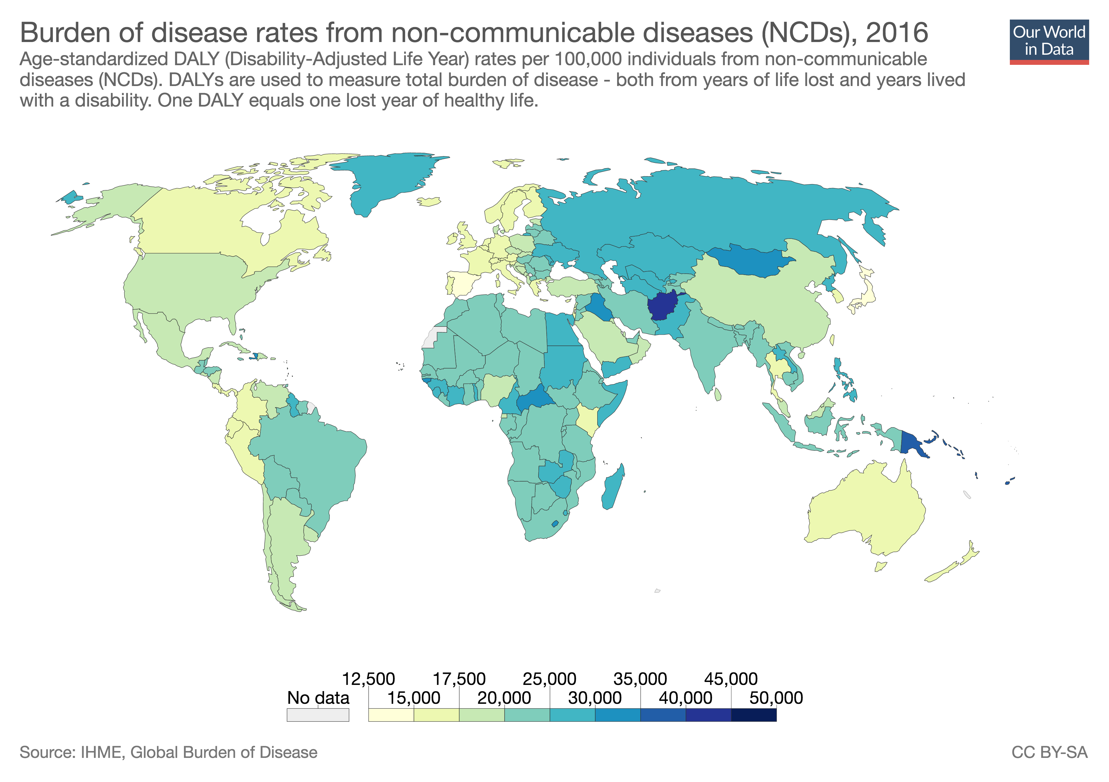

Slide 36
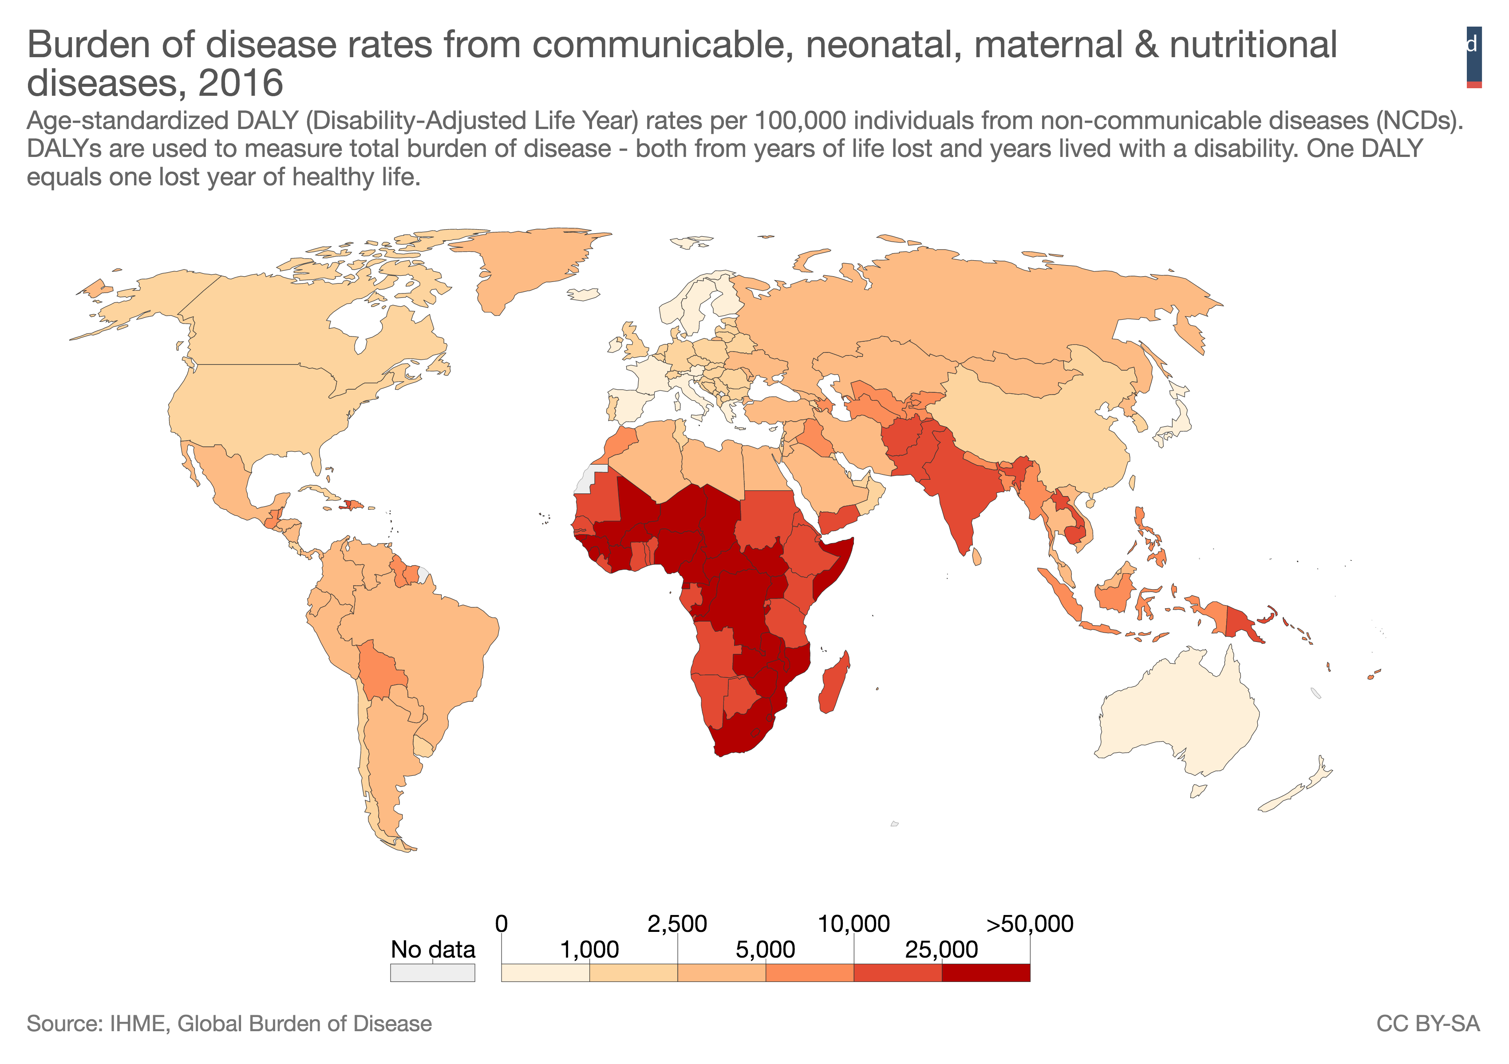

Slide 37
Pathophysiology of CVD in HIV infections
European Heart Journal (2014) 35, 1373–1381

Slide 38
Draw a causal diagram – HIV and CVD

Slide 39
How can we estimate burden?

Slide 40
Types of epidemiological estimates / measures of risk
Descriptive /
Frequency/
Count
Measures of association
Measures of public health impact
Notes:
Ratio = 3,151 ⁄ 189 × 1 = 16.7:1. This is a ratio

Slide 41
Descriptive /
Frequency/
Count
Measures of association
Measures of public health impact
Notes:
Prevalence of HIV by country

Slide 42
Descriptive /
Frequency/
Count
Measures of association
Measures of public health impact
Notes:
Risk of CVD due to HIV infection
- Sources

Slide 43
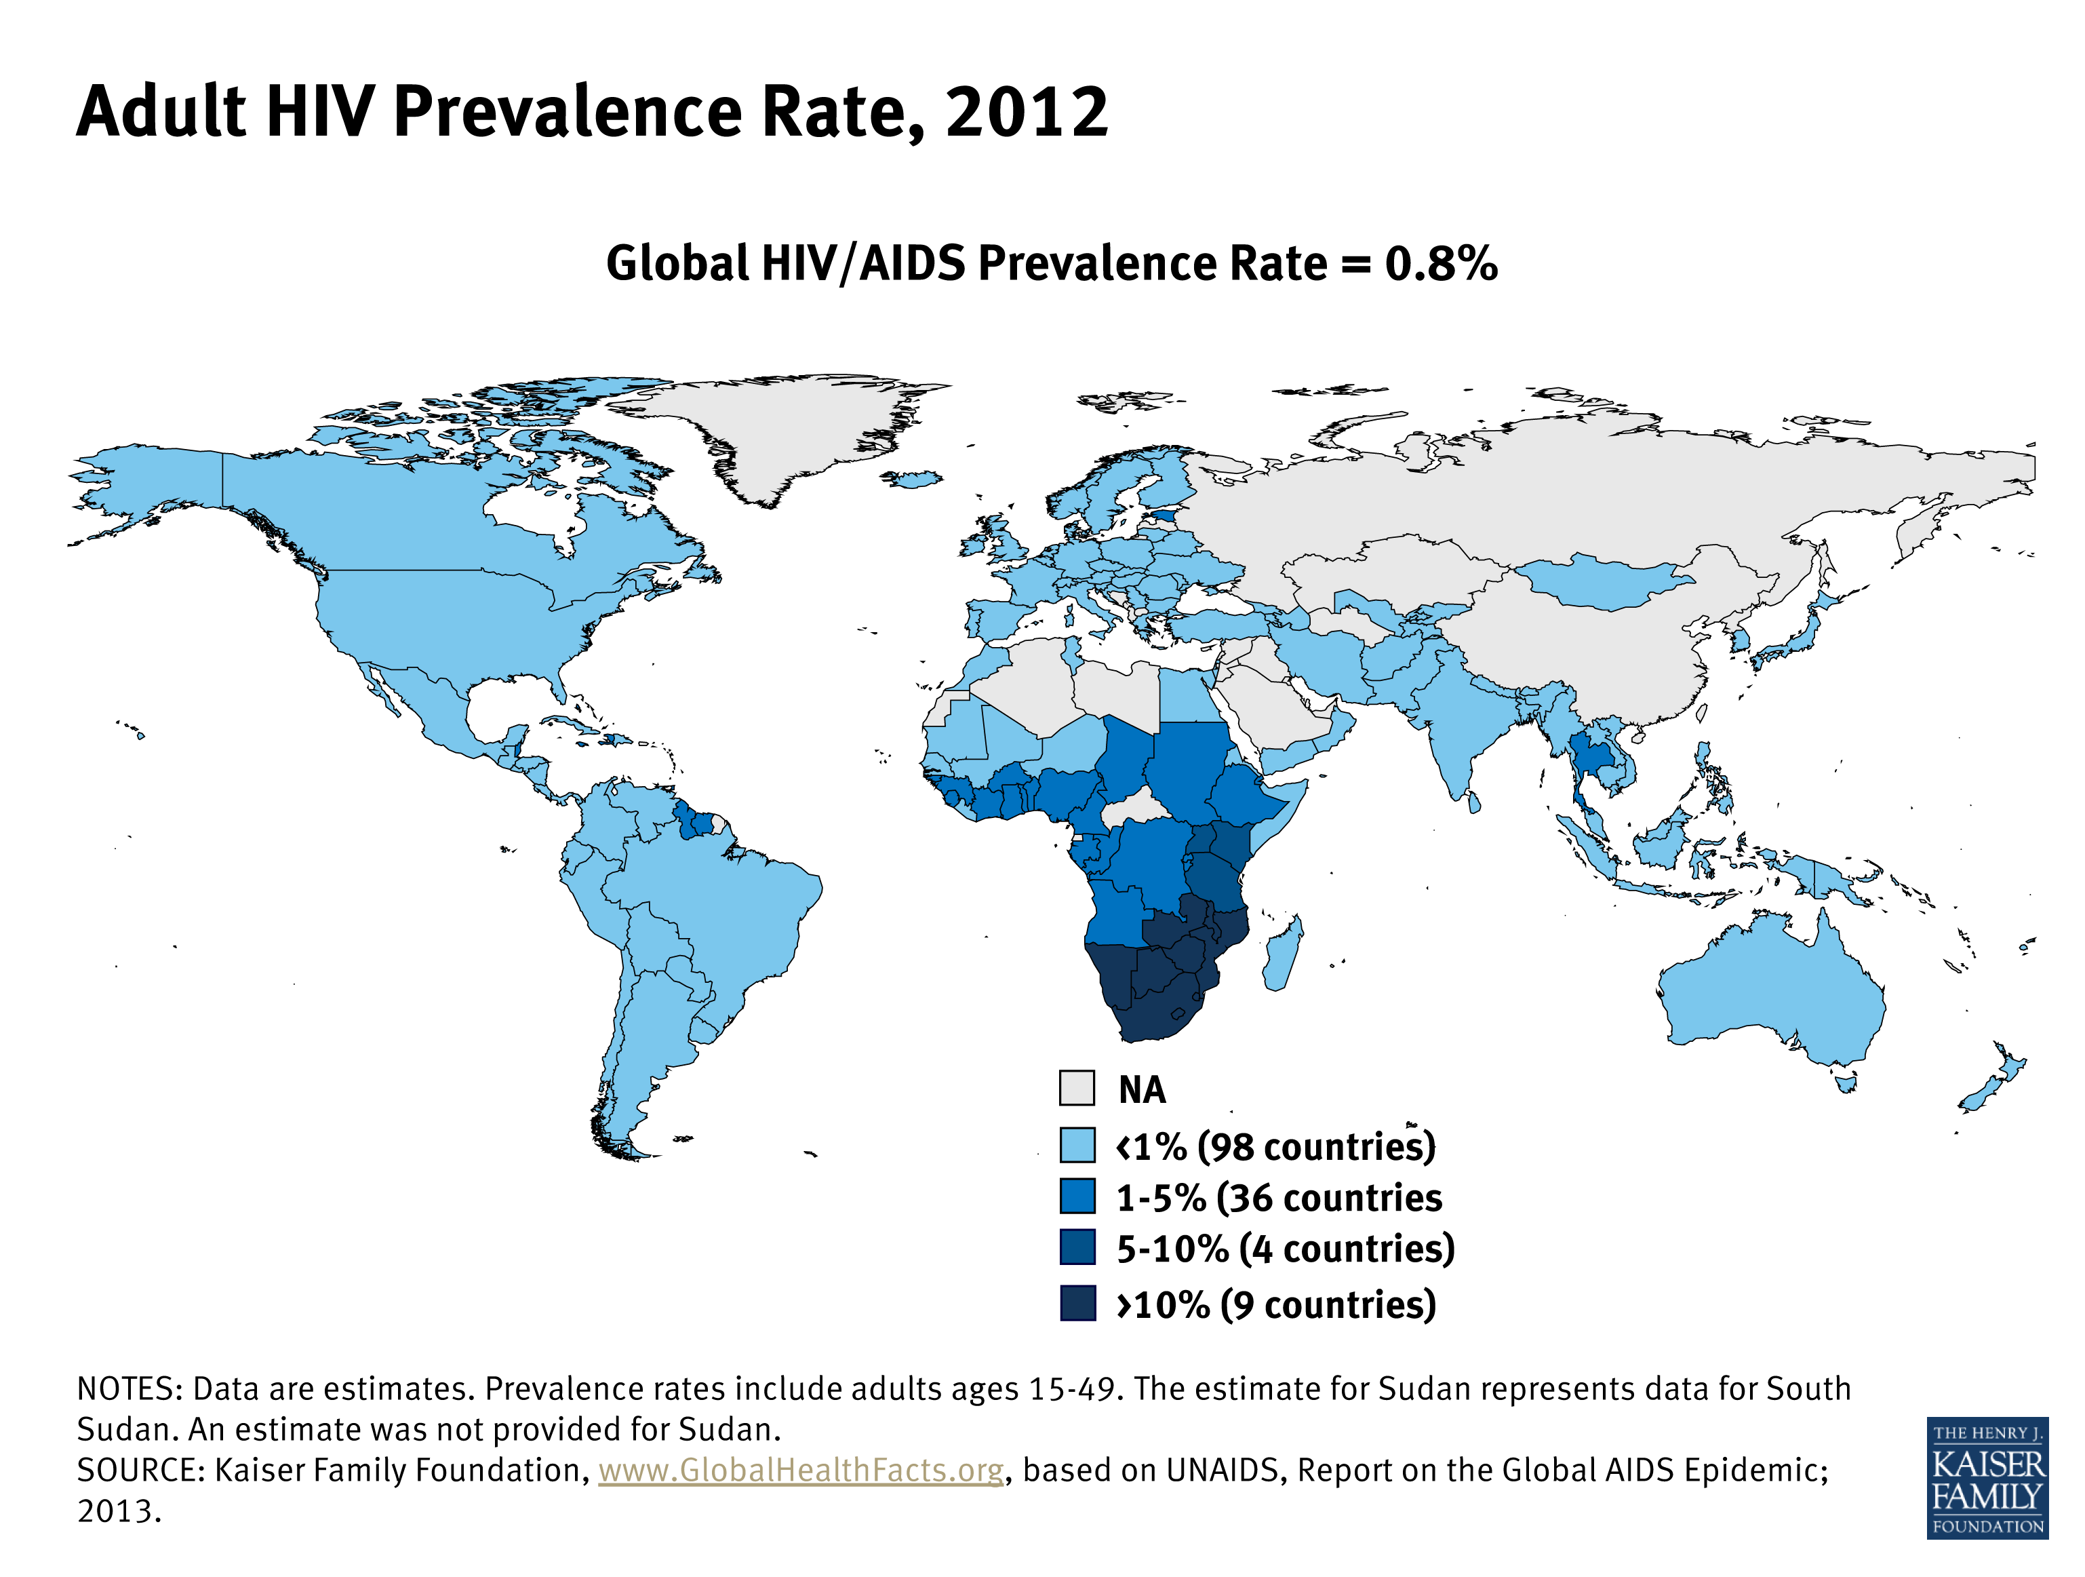
Descriptive /
Frequency/
Count
Measures of association
Measures of public health impact
Notes:
Prevalence of HIV by country

Slide 44
Descriptive /
Frequency/
Count
Measures of association
Measures of public health impact
Notes:
Prevalence of HIV by country

Slide 45
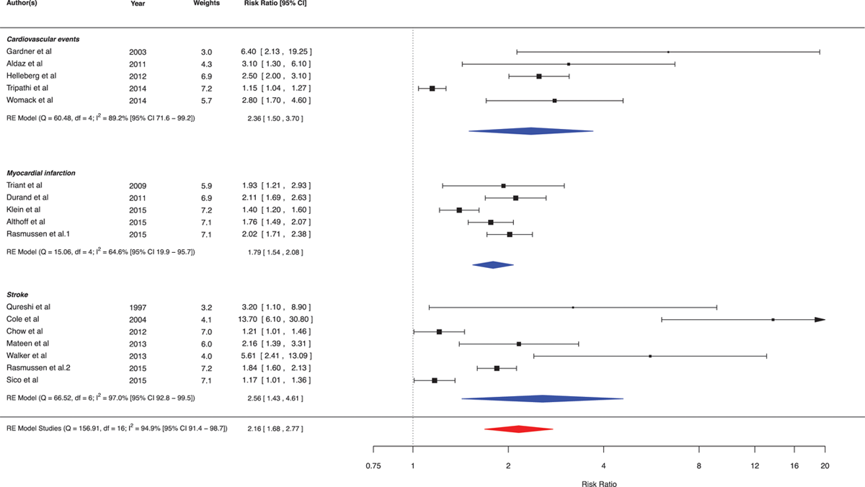
Systematic review of HIV associated CVD
RR: 2.16
Global Burden of Atherosclerotic Cardiovascular Disease in People Living With HIV, Volume: 138, Issue: 11, Pages: 1100-1112, DOI: (10.1161/CIRCULATIONAHA.117.033369)

Slide 46
Prevalence
RR
?
Notes:
Prevalence of HIV by country

Slide 47
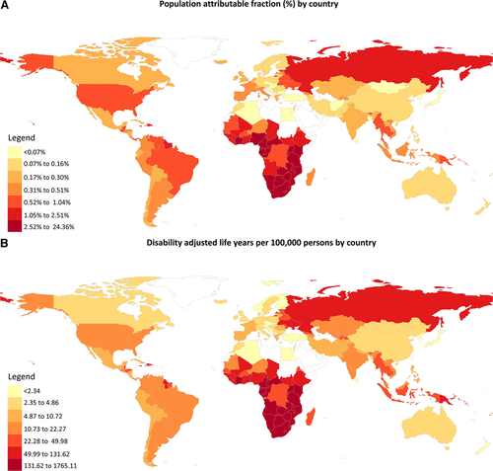
Prevalence
RR
PAF
Notes:
Prevalence of HIV by country

Slide 48
Descriptive /
Frequency/
Count
Measures of association
Measures of public health impact
Attributable risk
Population Attributable Fraction
Notes:
Risk of CVD due to HIV infection
- Sources

Slide 49
Descriptive /
Frequency/
Count
Measures of association
Measures of public health impact
Attributable risk
Population Attributable Fraction
Notes:
Risk of CVD due to HIV infection
- Sources

Slide 50
Descriptive /
Frequency/
Count
Measures of association
Measures of public health impact
Attributable risk
Population Attributable Fraction
CVD
DALYs due to HIV
CVD
DALYs
Notes:
Risk of CVD due to HIV infection
- Sources

Slide 51
CVD DALYs Attributable to HIV

Slide 54
Conclusion
Understand the different measures of descriptive epidemiology
Understand measures of risk
Never forget about confounding!
Both parameters can be combined to derive powerful metrics of burden that can be used to drive policy change and decisions

